Slide 1
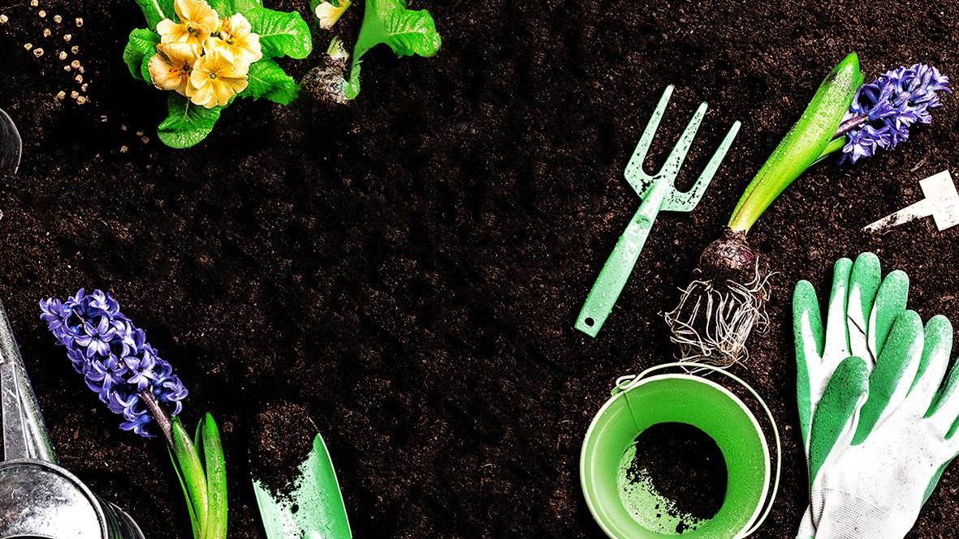
Gardening
Algorithm Capstone
Team members:
Kasha Muzila
Karl Eirich
Robert Turnage
Cynthia Zhu
Notes:
Timestamp: 7.25sec

Slide 2

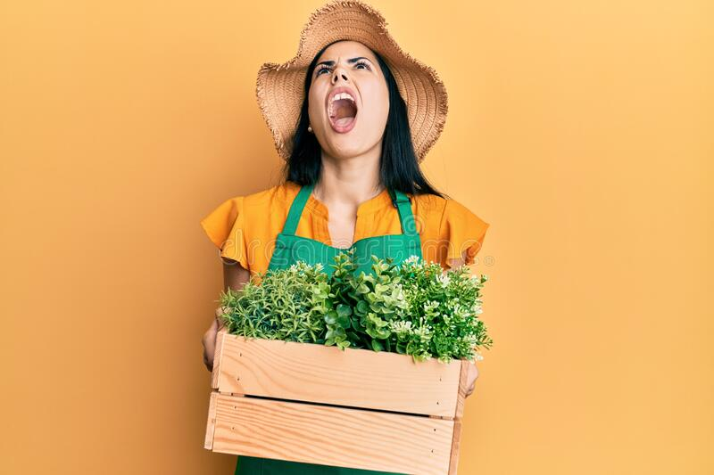
“I can’t plant more than 75% of them!”
“I spent all that time and money just to wait for a different time to plant!”
Notes:
Image: https://www.dreamstime.com/photos-images/angry-gardener.html
Timestamp: 49.37sec

Slide 3



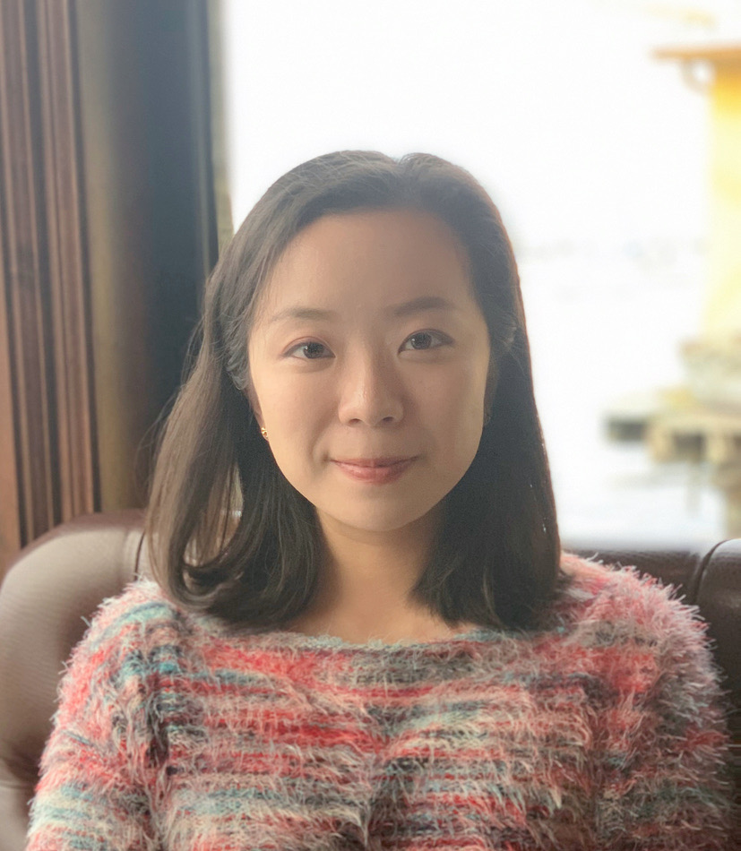


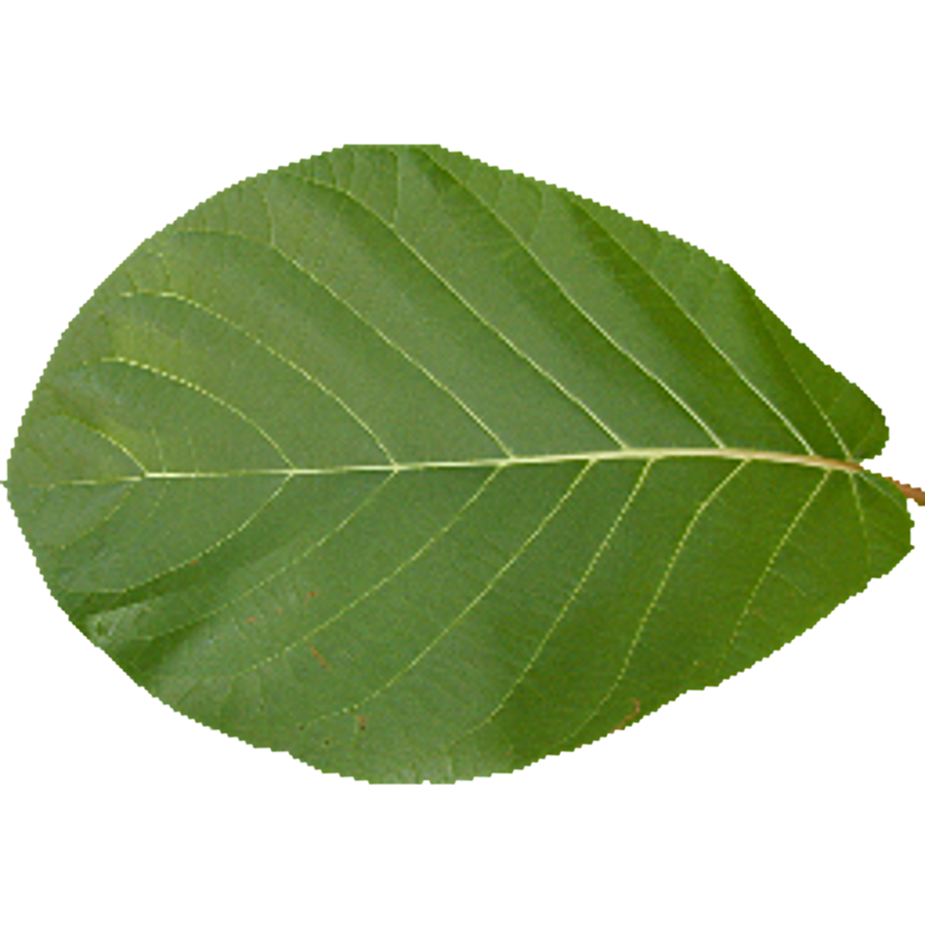
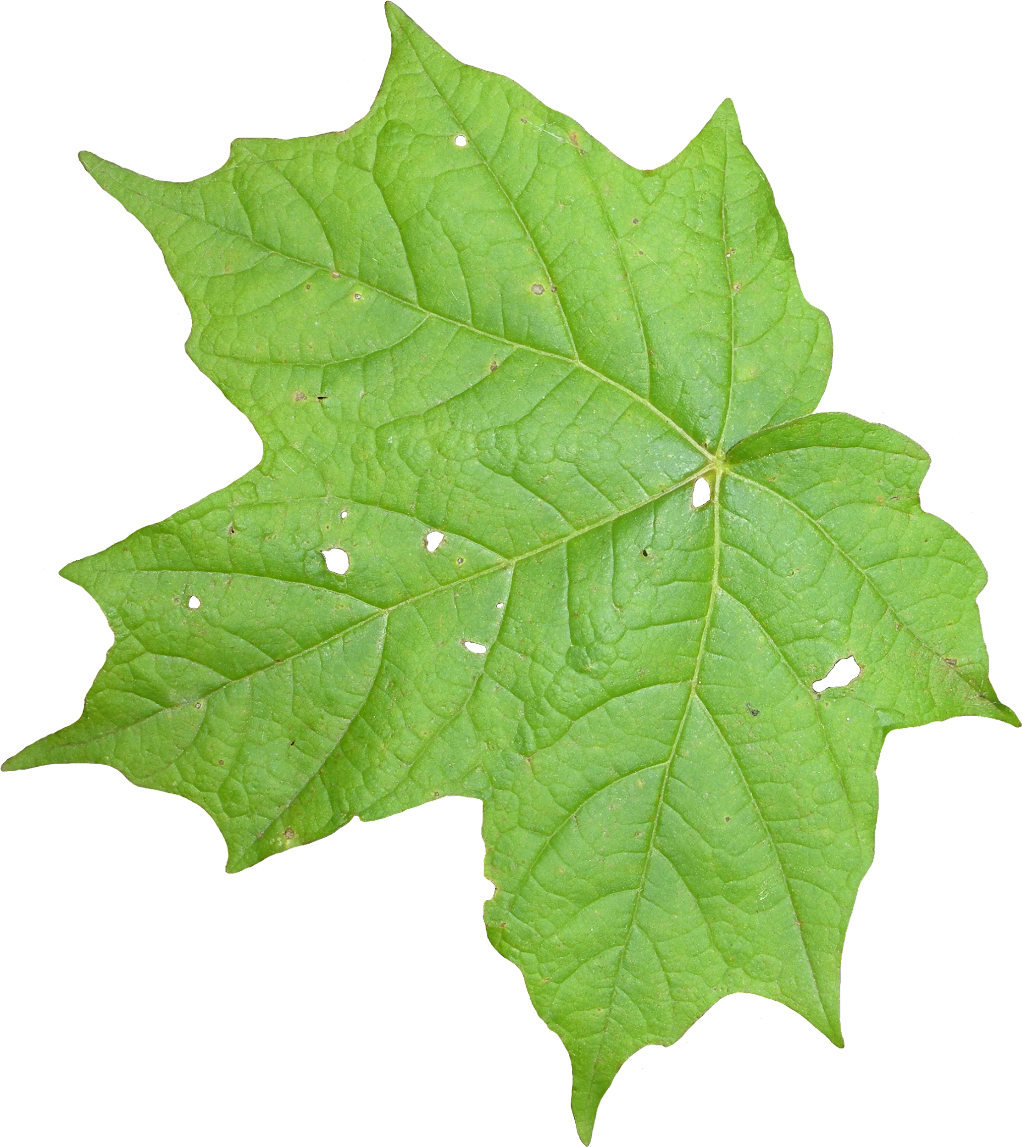
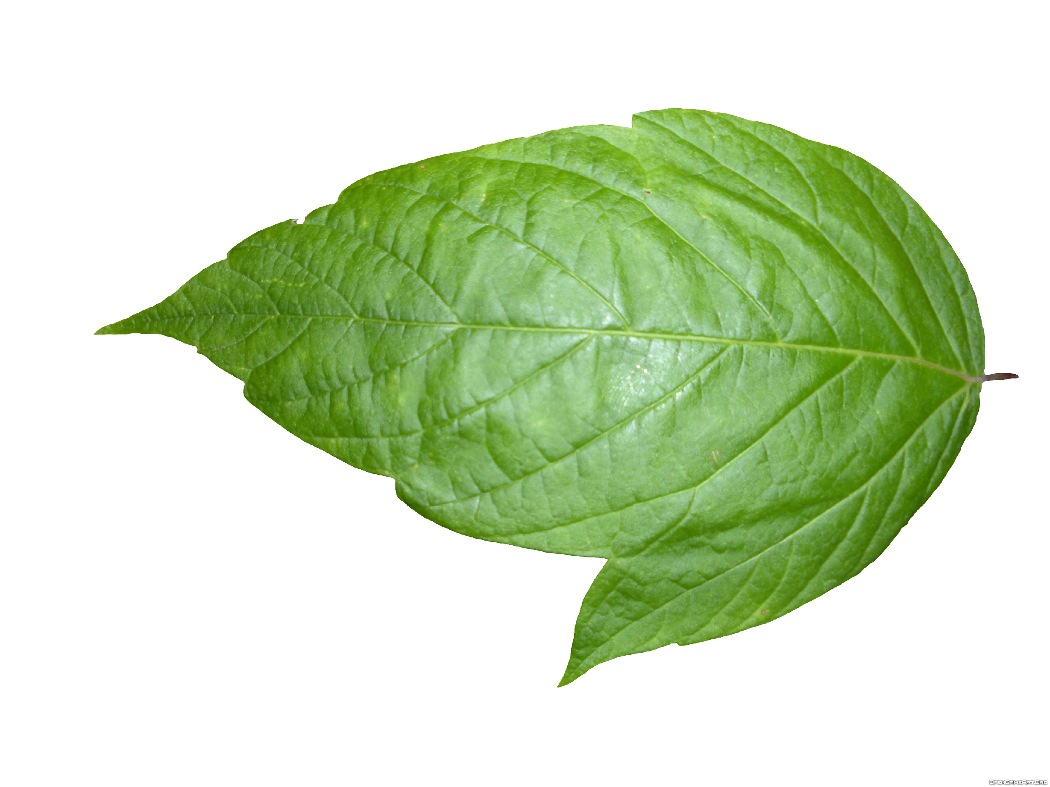
The Team
Kasha
Robert
Cynthia
Karl
Machine Learning Engineer
& Data Engineering
Product Manager
& Information Architecture
Data Science & Machine Learning Engineer
Data Architecture & Engineering
Notes:
Timestamp: 16.08sec

Slide 4


Recommendation Technology
Simplify the learning curve for beginner gardeners
Website and mobile app that can suggest what to plant in a hobby garden based on the number of sun hours, zone, time of year, the direction your garden is facing, and frost dates
Make budgeting for advanced gardeners more efficient
Notes:
Timestamp: 45.15sec

Slide 5

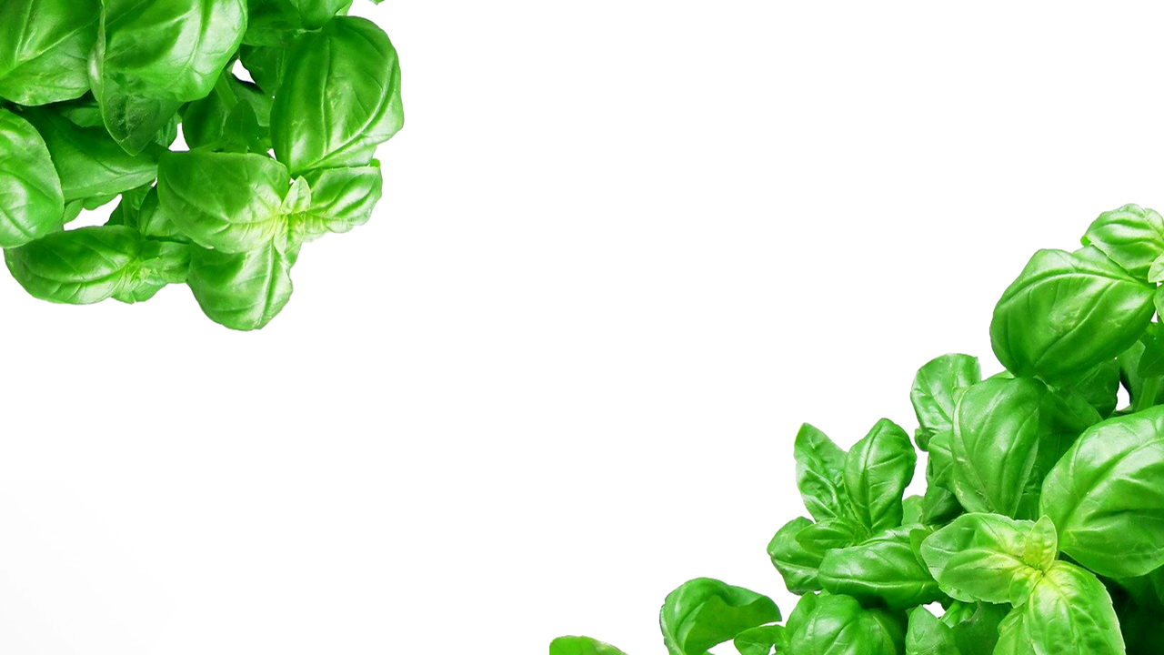
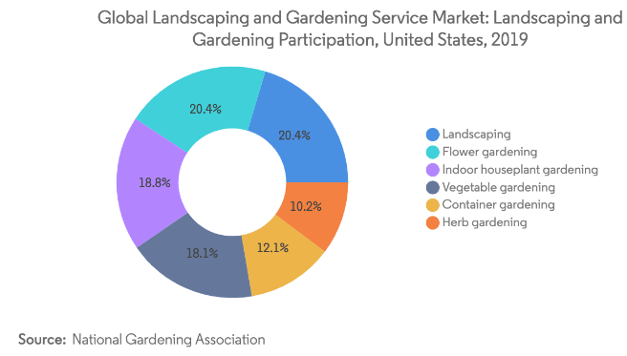


Market Opportunity
Before Launch:
300 users
After Launch:
~50,000 users
House Plant Market:
+90,000 users
$93 Billion
2018
Notes:
Pie chart: https://www.mordorintelligence.com/industry-reports/landscaping-and-gardening-service-market
Timestamp: 51.53sec

Slide 6
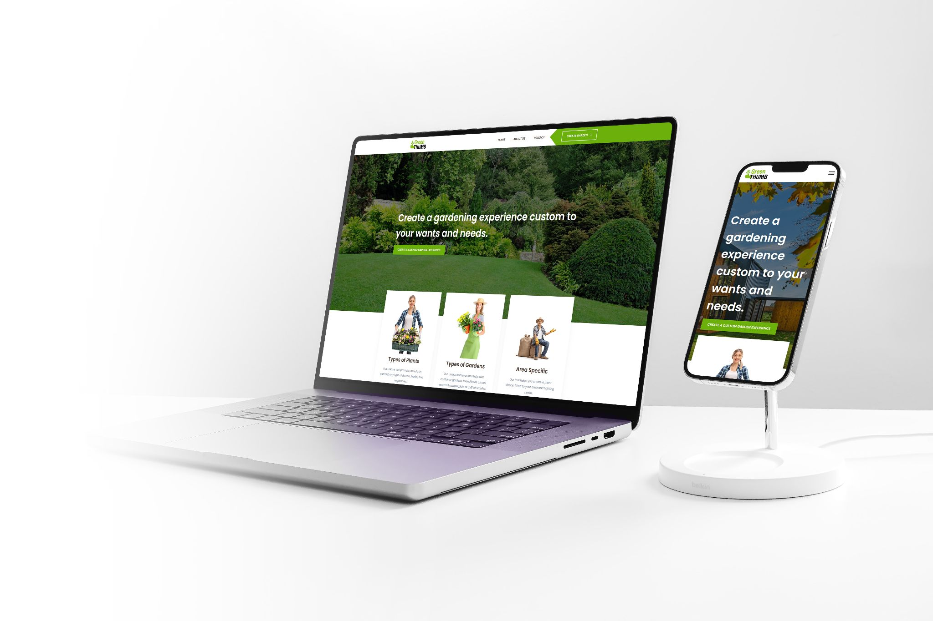

Let’s Take a Look!
Easy to use having a form factor for usage on Web 2.x or Mobile platforms.
Design is aligned to the stories in scope for three gardener types Veggies-t, Aesthetics-t, Hybrid-ers.
Open to beginners or experienced gardeners alike.
GreenThumb.ai | Homepage http://20.127.87.137
Notes:
Split into two parts
Walkthrough on how website would help new users (kasha’s mom)
Mention how to fine tune recommendation and the purpose of the survey (recommendation system slide before testimonial slide)

Slide 7

Data Engineering
Manually curated data from multiple sources
Scraped from companies, universities, and community forums
Data quality varied between sources
Plant pictures were particularly varied
Plant details fluctuated in specificity
Around 50000 plants across 16 unique plant types
Data stored in parquet files due to size

Slide 8
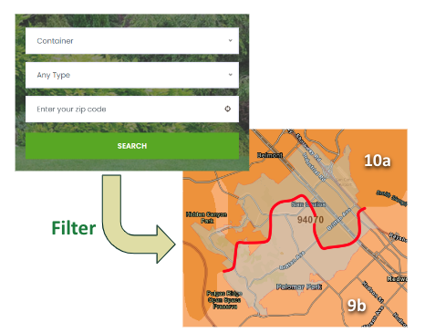
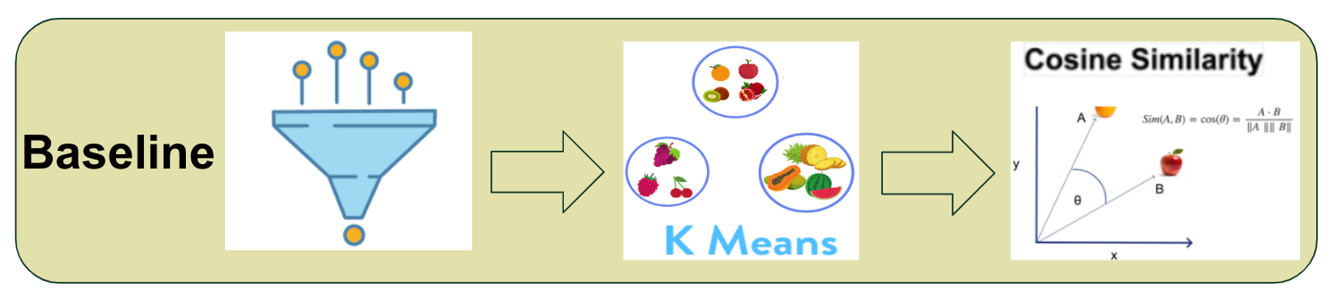

Recommendation Baseline
Similarity score
0.3
Metrics
Cosine similarity measures the similarity between plant of interest and suitable plants in the database.
Notes:
Cynthia’s 1.5mins.

Slide 9


Technical Evaluation
With feature engineering,
43.5% increase in information entropy

Slide 10
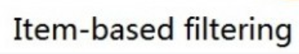
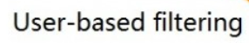
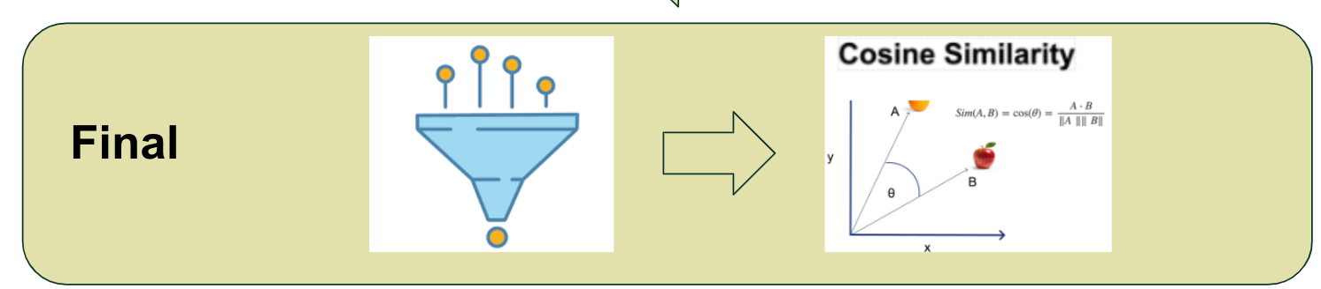
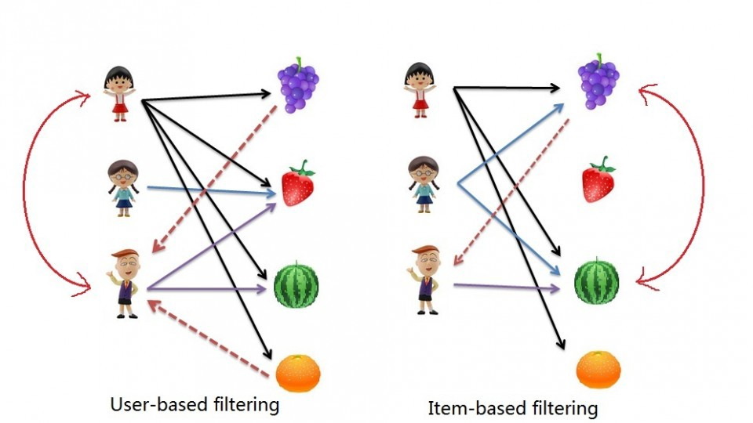
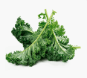
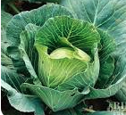
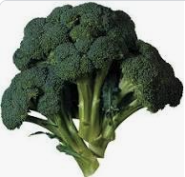
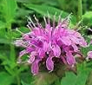
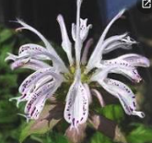

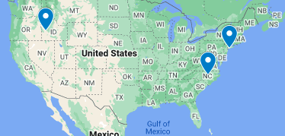
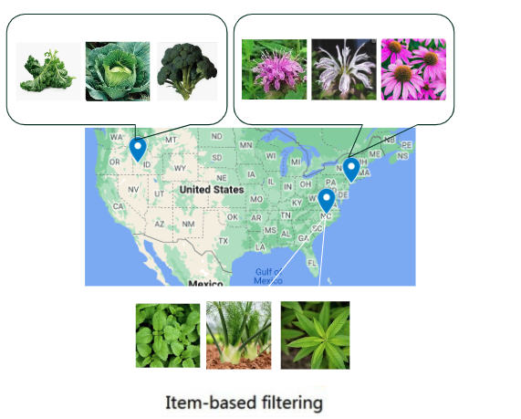

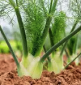
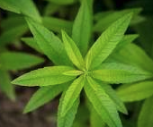
Recommendation Engine
Similarity score
0.7
Survey
Notes:
1:10min.

Slide 11


Testimonial:
Susan Muzila
“Most Definitely! Because it gives me a chance to see all of the plants so I can narrow it down and give it to our landscaper.”
“I like that feature, I bet that there are many websites that don’t give you that option at all.”
“I love the pictures!...and the added invasive species feature!”
Background
Age: 55-65
Married with 2 adult children
Education: Undergraduate
Role: Executive Assistant
Job measured: alleviates additional duties of Medical Director
Reports to: Medical Director
Skills required: organization, communication, project management
Company Information
Industry: Medical
Yearly Revenue: $60k
Employees: 5000
https://youtu.be/no4zo4ZibeM
Notes:
Timestamp: 29.73sec

Slide 12

Key Takeaways
3 Technical Challenges
Scrapping the initial plant dataset
Unifying and normalizing the plant dataset
Huge learning curve with building the front end of the website
3 Detailed Learnings
Effective labeling had a huge improvement on modeling
Using K-means clustering is computationally unstable with unique dataset at each run.
Using Global Horizontal Irradiation (GHI) instead of Direct Horizontal Irradiation (DHI) increased range in recommendations
Users will have … | User willing to provide …
a basic understanding of gardening terminology (i.e., compost, tilling, container, frost date, etc.) basic to intermediate website/app navigation skills | Information on: planting zone/ zip code direction their garden is facing one or more plants that they would like to garden
Notes:
Timestamp: 32.61sec

Slide 13

Future
Opportunities
Machine visual to assess garden bed
Suggest plant layout based on cart
Connect to partner for co-sale opportunity
Funnel user to local businesses for in person shopping experiences

Slide 14
Wrap Up
Our app has a data science algorithm that provides suggestions on what to plant in the hobby garden based on initial environmental conditions to ensure that anyone interested in starting a hobby garden retains their excitement and has a fun and easy experience while planning.
Notes:
Ever struggled to learn gardening, and always wanted to learn but don’t have time.
Our app has a data science algorithm that provides suggestions on what to plant in the hobby garden based on initial environmental conditions.
Now the budding novice can become the master with guidance and ease, no waste and desired results.

Slide 15

Thank
You

Slide 16
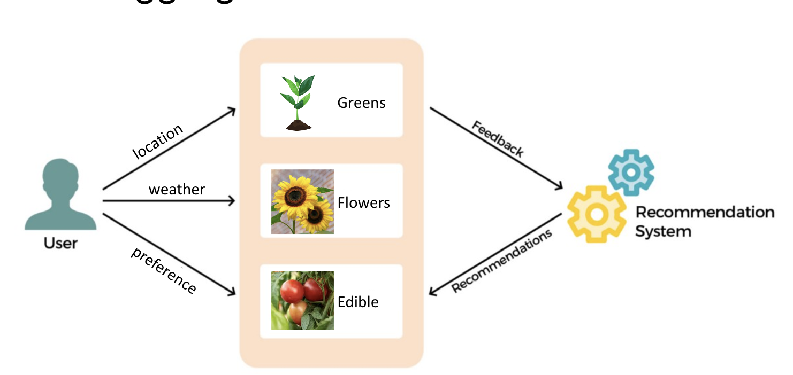
Recommendation Engine

Slide 17

Overview
Kasha
Problem (Kasha’s Story)
While turning my apartment balcony into a semi-self-sustaining vegetable garden, I have run into the bottleneck of figuring out what to plant based on the initial environmental conditions of my balcony. I have spent dozens of hours researching to finally come up with a list of vegetables to plant, only to find out that I cannot plant half of them because it is not during the optimal season. This also includes pest-resistant plants that are an imperative companion plant for some vegetables, causing the number of feasible vegetables to plant to be less than half of everything purchased.
Impact
Why is this problem important to solve?
A website/app that can suggest what to plant in a garden based on the number of sun hours, zone, time of year, the direction your garden is facing, and frost dates would help save time and money when planting a garden. Additionally, the learning curve for beginner gardeners is so high that many are too afraid to start. This website/app would be able to simplify the learning curve into smaller chunks so beginners can purchase and learn about the plants that they can plant right now instead of all plants from every season. For more advanced gardeners, this would make budgeting more efficient as they can see what they can plant based on their initial preferences and can price compare before investing. A future outlook for this project is to function like the Kayak website but with consolidating gardening products into one website based on the user’s preferences. These preferences can be specific. For example, some users do not like to purchase from Amazon and prefer to purchase from a small business.
Green Thumb AI is a website and mobile app that can suggest what to plant in a hobby garden based on the number of sun hours, zone, time of year, the direction your garden is facing, and frost dates.
Additionally, the learning curve for beginner gardeners is so high that many are too afraid to start. This app would be able to simplify the learning curve into smaller chunks so beginners can purchase and learn about the plants that they can plant right now instead of all plants from every season. For more advanced gardeners, this would make budgeting more efficient as they can see what they can plant based on their initial preferences and can price compare before investing.
All of this would help enable gardeners of varying skills and knowledge to save time and money.
Notes:
Add catchy story on the overview

Slide 18
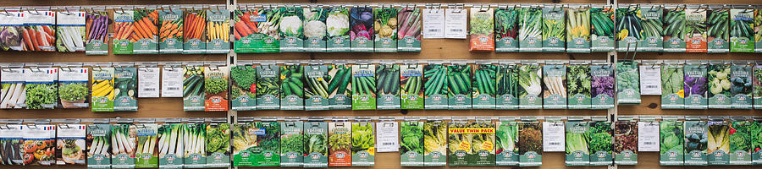
Problem Statement
Kasha
Improving the bottleneck of determining what to plant based on the initial environmental conditions
Website/app would be able to simplify the learning curve for beginners.
Would make budgeting more efficient for advanced gardeners

Slide 19
Future product vision (Karl)
Using vision recognition assess garden bed area
Using python recommend layout based on shopping cart selection of diameters to meet possible geometries for aesthetics or functional companion outcomes.
BCOM connection with partners for co-sell opportunities driving platform of community of market share. Similar business models to Streaming Music or eBooks. Eg. take shopping cart to Home Depot and check out via API purchasing.
Provide online shopping experience for BCom to lesser business entities like local nurseries.
** 5. Allow user to provide ratings/feedback
How can your model approach and way of solving the problem be generalizable?
Potentially generalizable to other similar or adjacent problems
Notes:
Add more story around market research

Slide 20
Market Research (Kasha)
Market research, extension, wider products, etc…
Market size
User size
Quantification on potential level of impact that product can deliver now and in the future if continued to work on it
Educated guess
How many items are in this universe, how will the DS keep up?
Hobby gardening promotes mental health, which extends the use case
Show how large plant data is in comparison
A future outlook for this project is to function like the Kayak website but with consolidating gardening products into one website based on the user’s preferences. These preferences can be specific. For example, some users do not like to purchase from Amazon and prefer to purchase from a small business.
Notes:
Add more story around market research

Slide 21
Presentation 3 Delivered on Dec 5th
Fill out this form: https://www.ischool.berkeley.edu/programs/mids/capstone/2022b-summer
Add demo video to this page
Things to add
Show App, Data, etc at scale architecture design
Show Market space interaction where plant vendors can join and interact with gardeners for market share and influence

Slide 22
Wrap-up (Karl)
Ever struggled to learn gardening, and always wanted to learn but don’t have time. Our app has a data science algorithm that provides suggestions on what to plant in the hobby garden based on initial environmental conditions. Now the budding novice can become the master with guidance and ease, no waste and desired results.
My team consists of four FTEs has a go to market strategy with significant market opportunity. First to data and customers wins the land grab!
How about a follow up meeting to take a deeper dive into the product feasibility as it is today and what we know about the opportunity.
Put sentence that states mission and approach (aka elevator pitch minus the team introduction and the ask)

Slide 23
Key Takeaways (Kasha)
Top 3 technical challenges you have overcome
Top 3 key detailed learnings from the model evaluation and error analysis

Slide 24
Feedback
Get user feedback on usage experience
get ground truth baseline from users experience for retrain cycles
Notes:
Add more story around market research

Slide 25

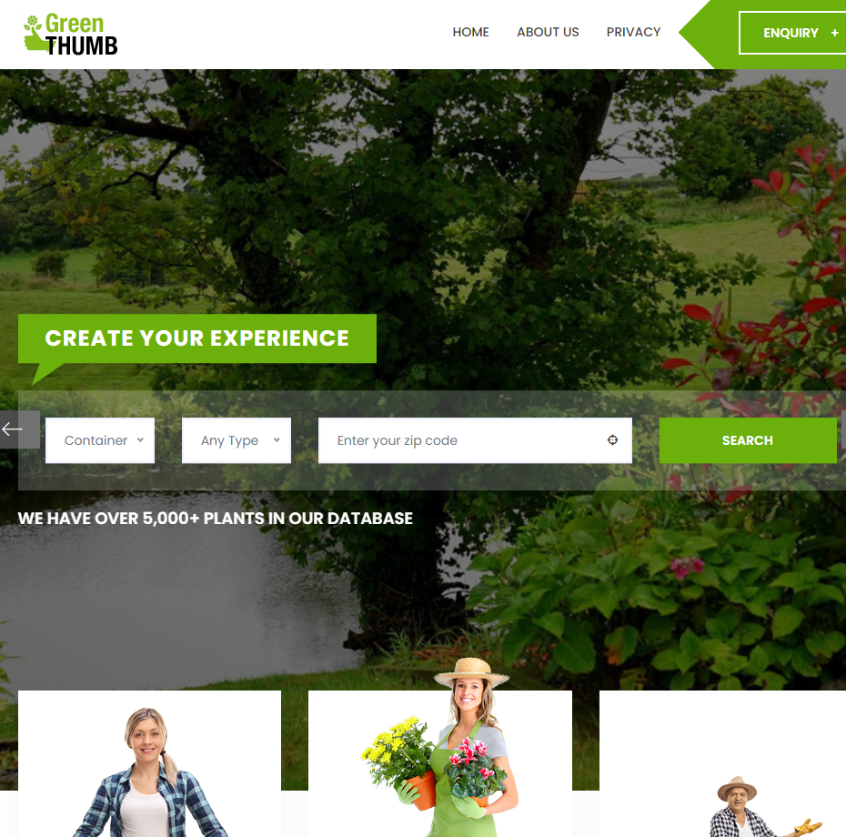
Robert
Having a compliant form factor for user usage on web 2.x or Mobile platforms.
Design is aligned to the stories in scope for three gardener types Veggies-t, Aesthetics-t, Hybrid-ers.
Still to come,... the design for user inputs that drive the model and the usage of outputs. Dependent on what we can achieve in time…
GreenThumb.ai | Homepage http://20.127.87.137
Notes:
Robert (1m)
10-15% -- describe the MVP and key features that directly relate back to the problem for the target user. Discuss, through the MVP, why your solution is differentiated. Put your product manager hat on. Anyone and everyone should understand what you are building, why the MVP makes sense and is compelling, and what impact your product will have on the initial set of end users or customers. What work is in progress to gain validation from your target user.

Slide 26
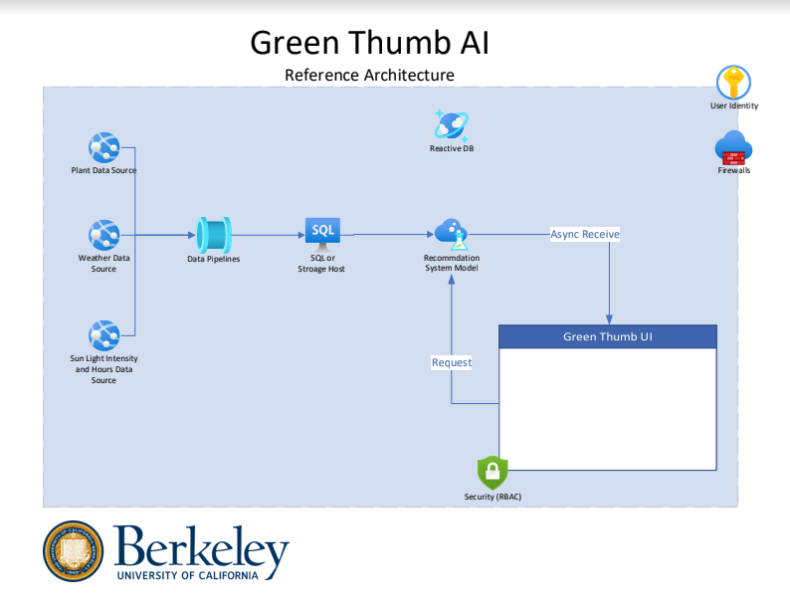

Architecture
Robert
This is a simple diagram showing our reference architecture.
Data ingestion via pipelines in python 3x. Clean and initial transformation. Final transformation and data science recommendation system pairing with MLOps on Cloud Machine Learning Platform (AML)
Notes:
Robert (30s)
60%- 70% -- technical discussion. For example: summarize data pipeline (30 sec), overall architecture (1 min), discuss model(s) and technique(s) in compelling details so that the audience (class) understand what you are building “under the hood” and why. Show and discuss the data science techniques used, how exactly you are applying the techniques in your project, challenges, trade-offs, current results. Put your CTO, data architect, data engineer, and data scientist hats on.

Slide 27









App Engineering
Robert
We are using HTML5, CSS3, JS (Bootstrap, React): Hosted on Azure VM Ubuntu 20.04 LTS
Using in Python 3.x Flask 2.x
With the logic for the data science model trained and hosted on Azure Machine Learning
Notes:
Robert (30s)
We are using HTML5, CSS3, JS (Bootstrap, React): Hosted in Python Flask on an Azure VM Ubuntu 20.04 LTS
With the logic for the data science model trained and hosted on Azure Machine Learning

Slide 28
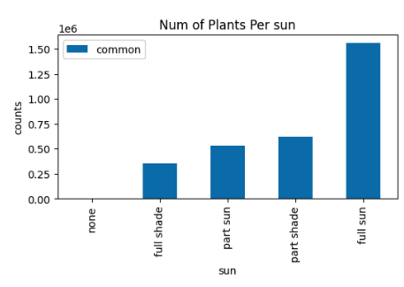
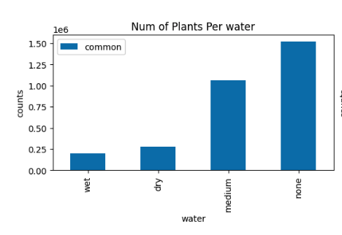
Data Engineering
Karl
Data normalization was done to increase join compatibility
The process was very manual but provided the granular control needed to align value formats
Columns were dropped that did not see data parity across other tables
Values were aggregated to prioritize the join without compromising the signal
Notes:
Karl (1m)

Slide 29
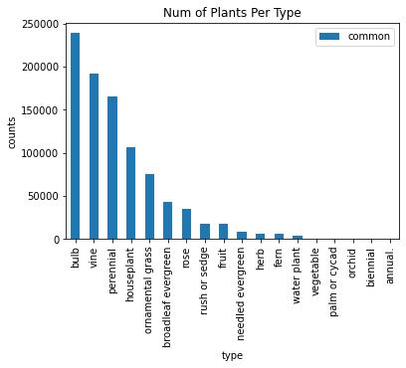
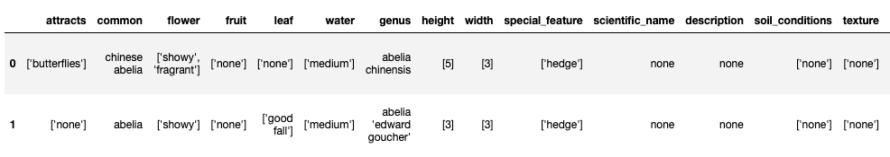
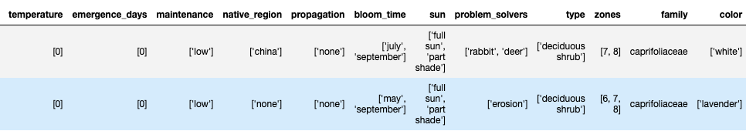
EDA - plants
Cynthia
Total plants: 3244, if excluding shrub/tree, 1143.
All Features: 25 features
-'attracts', 'flower', 'fruit', 'leaf', 'water', 'genus', 'height', 'width', 'special_feature', 'scientific_name', 'description', 'soil_conditions', 'texture', 'emergence_days', 'maintenance', 'native_region', 'propagation', 'bloom_time', 'sun', 'problem_solvers', 'type', 'zones', 'family', 'color', 'temp_bucket'
Feature Engineering:
Explode each category of feature into a separate record
Bucketize temperature to match the lookup table
Type of plants
Check features distribution
10 Features have >50% none value: Attracts, flower, fruit, leaf, scientific_name, description, soil_conditions, texture, native_region, emergence_days
Notes:
Cynthia (2m)

Slide 30
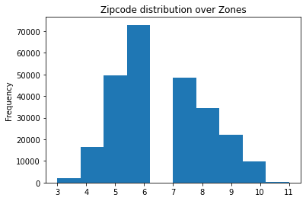
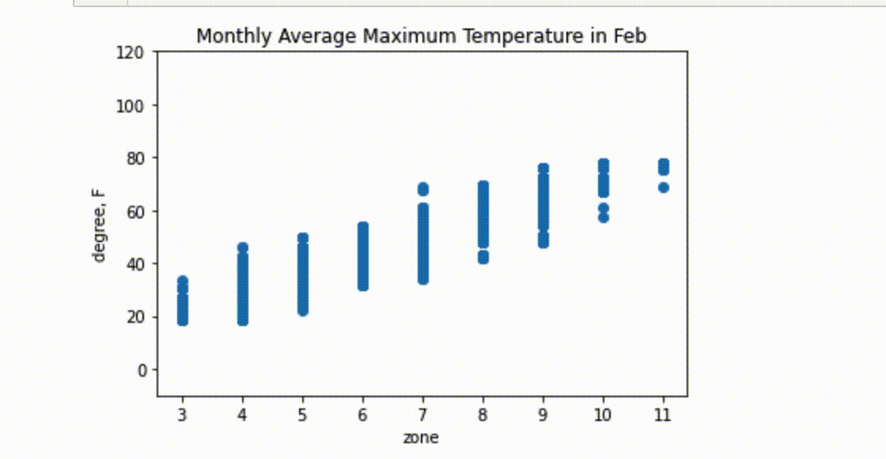
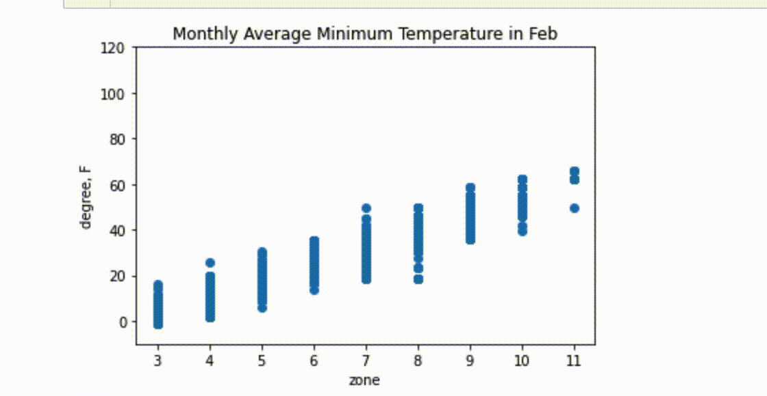
EDA - location-based weather dataset
Cynthia
Joined weather with planting zone by closest geospatial coordinates
210 cities with 2017-2020 temperature vs 21K zip code with designated planting zone → most of zip codes will share the same weather features
Zone has a relative normal distribution across US.
Zone correlates with temperature over Jan - Dec
Notes:
Cynthia (2m)

Slide 31
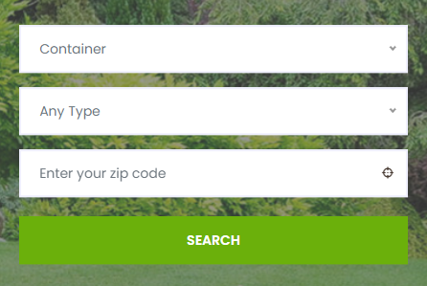

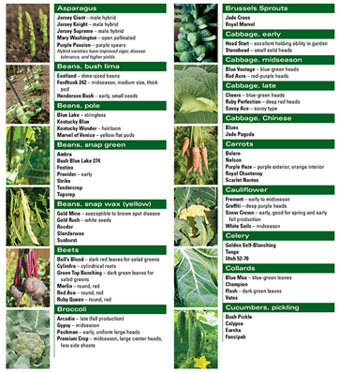
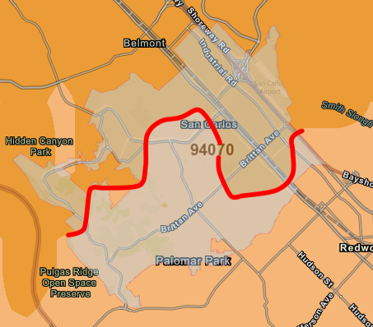


Model
Kasha
1. Filter Plant Dataset Using Zip Code
2. Use DS Model to Recommend Best Plants to Grow
10a
Filter
9b
Notes:
Kasha (30s) Updates on data science model, metrics, features, etc.

Slide 32
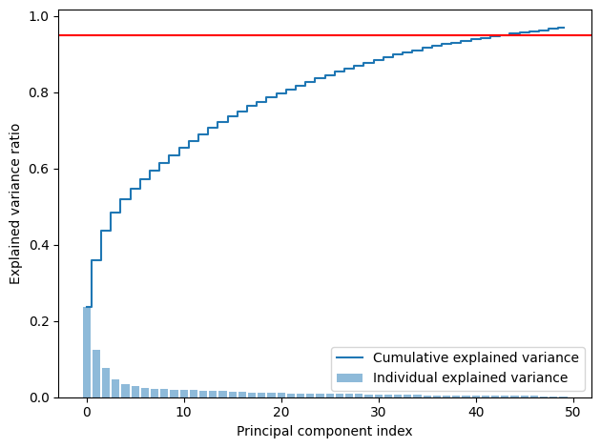
Model
Cynthia
Given the user’s zip code, we find zone, sunhour, temp_bucket based on tmax and tmin → subset plant data that meet above criteria
Remove the features have >50% null value
PCA and selected cutoff at 95% explained ratio
Modeling:
DBSCAN to select optimum number of clusters → all -1 label, no proper cluster found
KMeans, gridsearch give k=300 with silhouette score of 0.18.
Notes:
Cynthia (1m)

Slide 33
Data Privacy Consideration Overview
Team Name: Green Thumb AI Description: Algorithm that suggests recommendations for what to plant in the small garden based on initial environmental conditions.
Kasha
Data Privacy Consideration | In-Scope for Capstone Project to address. Actions: | Out-Scope for Capstone Project to address. Possible solution:
FTC Principles circa 2012 | Data Collection (Zip Code). We do not persist this data and we do not aggregate or persist with IP tracing or tracking. Data Usage is within the session state and is ephemeral. | Security considerations, should be designed and implemented for production. Current state of system can implement B2C/B2B RBAC and identity management for AuthN/AuthZ requirements.
CALOPPA | There is no tracking via web or mobile. Azure platform is used for hosting in the cloud Data Privacy in the Trusted Cloud | Microsoft Azure | (BCOM) PCI-DSSv3 will not be enabled in this feasbillity version, but is a consideration for production ready edition.
Notes:
Kasha(1m)
Include the data privacy consideration slide (template will be distributed). List considerations for your project and provide clear but succinct information about how you addressed privacy considerations in-scope for Capstone, and note those that will be out of scope.

Slide 34
Next Steps Post MVP
Karl
Notes:
Karl (30s)
10% - 20% -- discuss the remaining major work / roadmap of the project, project management for the remainder of the semester, help needed, and wrap up with a strong closing summarizing the mission of the project.

Slide 35
Karl
Thank
You

